Slide 1

Interface, Class & Package
Your success is our success
Funny Gorilla 诙猩猩
Notes:
Notes for title slide

Slide 2
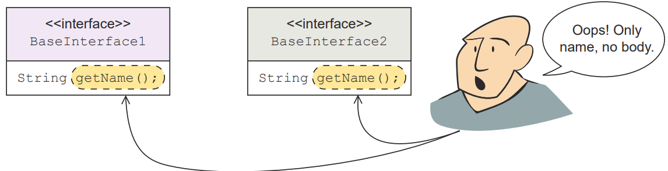
Interface

Slide 3
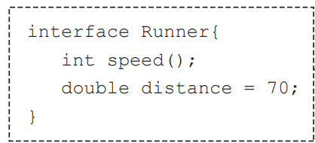
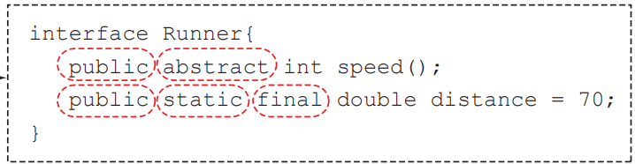
All the methods of an interface are implicitly public. Its variables are implicitly public, static, and final

Slide 4
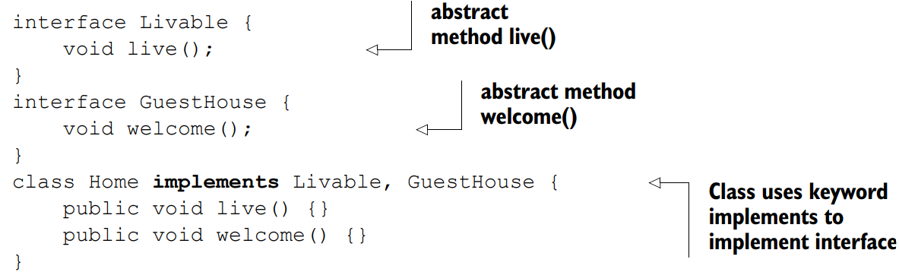
Is a relationship

Slide 5
Class

Slide 6
Package
Organize java classes
Void naming conflict

Slide 7
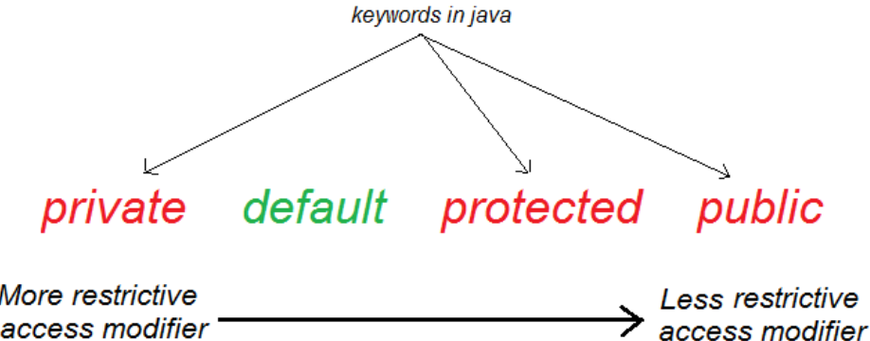
Method Access
Within class
Within package
Within package + inheritance

Slide 8
Inheritance

Slide 9
inheritance
Interface
extends
Interface
implements
implements
Abstract Class
extends
extends
Class
Class
Class
create
extends
Object
Class

Slide 10
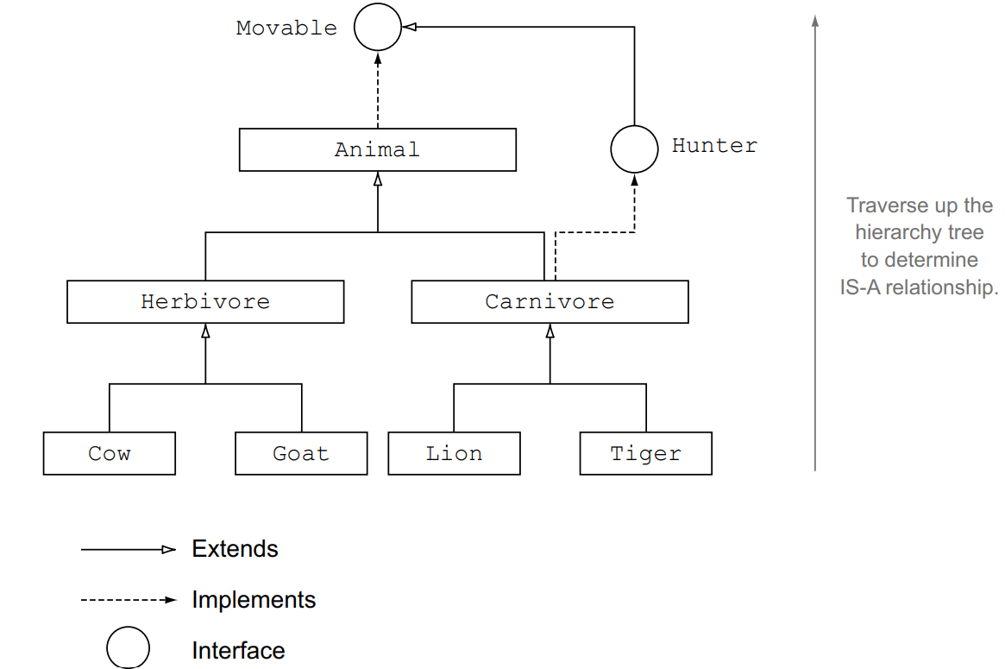

Slide 11
Sample inheritance
Person
implements
implements
Student
Lecturer
extends
extends
extends
Finance majored
CS majored
CS Lecturer
Finance Lecturer
create
Object

Slide 12
Demo access level

Slide 13
Reference
https://www.callicoder.com/java-arraylist/

Slide 14

Your success is our success
Contact
Mail: info@funnygorilla.com.au
Linkedin: https://mt.linkedin.com/in/songqing-gu-2ba9034b/de
Web Chat: FunnyGorilla
Phone: 0420891343

